Slide 1
Basic Business Statistics
11th Edition
Chapter 12
Chi-Square Tests and Nonparametric Tests

Slide 2
Learning Objectives
In this chapter, you learn:
How and when to use the chi-square test for contingency tables
How to use the Marascuilo procedure for determining pairwise differences when evaluating more than two proportions
How and when to use the McNemar test
How to use the chi-square test for a variance or standard deviation
How and when to use nonparametric tests

Slide 3
Contingency Tables
Contingency Tables
Useful in situations involving multiple population proportions
Used to classify sample observations according to two or more characteristics
Also called a cross-classification table.

Slide 4
Contingency Table Example
Left-Handed vs. Gender
Dominant Hand: Left vs. Right
Gender: Male vs. Female
2 categories for each variable, so
called a 2 x 2 table
Suppose we examine a sample of
300 children

Slide 5
Contingency Table Example
(continued)
Sample results organized in a contingency table:
Gender | Hand Preference
 | Left | Right
Female | 12 | 108 | 120
Male | 24 | 156 | 180
 | 36 | 264 | 300
sample size = n = 300:
120 Females, 12 were left handed
180 Males, 24 were left handed

Slide 6
χ² Test for the Difference Between Two Proportions
H₀: π₁ = π₂ (Proportion of females who are left
handed is equal to the proportion of
males who are left handed)
H₁: π₁ ≠ π₂ (The two proportions are not the same –
hand preference is not independent
of gender)
If H₀ is true, then the proportion of left-handed females should be the same as the proportion of left-handed males
The two proportions above should be the same as the proportion of left-handed people overall

Slide 7
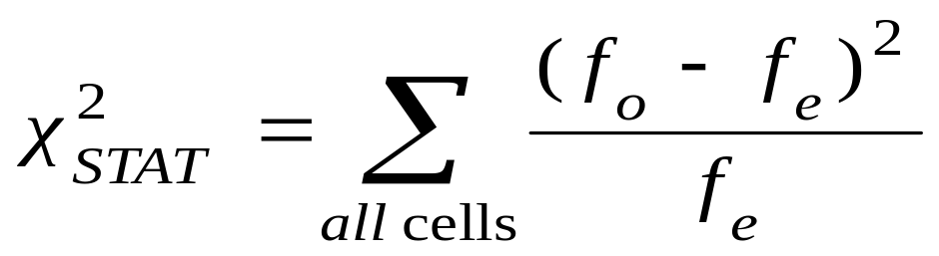
The Chi-Square Test Statistic
The Chi-square test statistic is:
where:
f_{o} = observed frequency in a particular cell
f_{e} = expected frequency in a particular cell if H₀ is true
(Assumed: each cell in the contingency table has expected
frequency of at least 5)

Slide 8
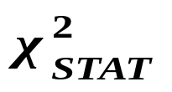
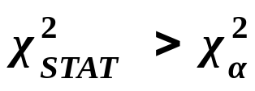
Decision Rule
The test statistic approximately follows a chi-squared distribution with one degree of freedom
Decision Rule:
If , reject H₀, otherwise, do not reject H₀
α
0
χ²
Do not
reject H₀
Reject H₀
χ²_{α}

Slide 9
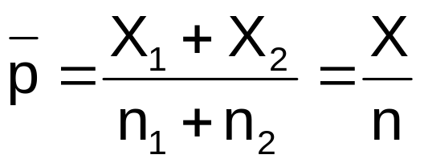
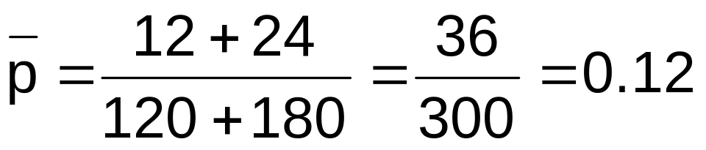
Computing the
Average Proportion
The average proportion is:
120 Females, 12 were left handed
180 Males, 24 were left handed
Here:
i.e., of all the children the proportion of left handers is 0.12, that is, 12%

Slide 10
Finding Expected Frequencies
To obtain the expected frequency for left handed females, multiply the average proportion left handed (p) by the total number of females
To obtain the expected frequency for left handed males, multiply the average proportion left handed (p) by the total number of males
If the two proportions are equal, then
P(Left Handed | Female) = P(Left Handed | Male) = .12
i.e., we would expect (.12)(120) = 14.4 females to be left handed
(.12)(180) = 21.6 males to be left handed

Slide 11
Observed vs. Expected Frequencies
Gender | Hand Preference
 | Left | Right
Female | Observed = 12 Expected = 14.4 | Observed = 108 Expected = 105.6 | 120
Male | Observed = 24 Expected = 21.6 | Observed = 156 Expected = 158.4 | 180
 | 36 | 264 | 300

Slide 12
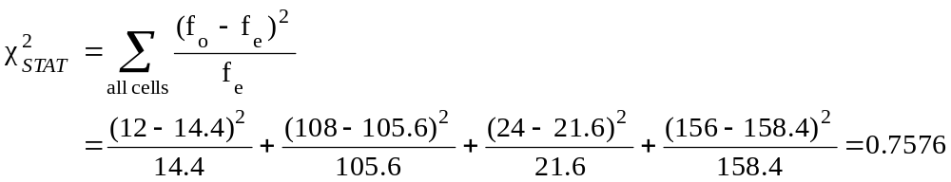
The Chi-Square Test Statistic
Gender | Hand Preference
 | Left | Right
Female | Observed = 12 Expected = 14.4 | Observed = 108 Expected = 105.6 | 120
Male | Observed = 24 Expected = 21.6 | Observed = 156 Expected = 158.4 | 180
 | 36 | 264 | 300
The test statistic is:

Slide 13
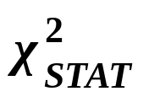
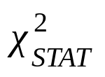
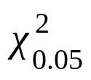
Decision Rule
Decision Rule:
If > 3.841, reject H₀, otherwise, do not reject H₀
Here,
= 0.7576< = 3.841,
so we do not reject H₀ and conclude that there is not sufficient evidence that the two proportions are different at α = 0.05
0.05
0
χ²
Do not
reject H₀
Reject H₀
χ²_{0.05} = 3.841

Slide 14
χ² Test for Differences Among
More Than Two Proportions
Extend the χ² test to the case with more than two independent populations:
H₀: π₁ = π₂ = … = π_{c}
H₁: Not all of the π_{j} are equal (j = 1, 2, …, c)

Slide 15
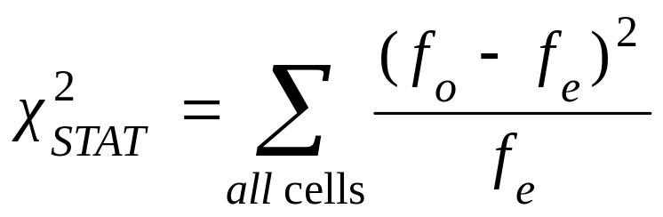
The Chi-Square Test Statistic
The Chi-square test statistic is:
Where:
f_{o} = observed frequency in a particular cell of the 2 x c table
f_{e} = expected frequency in a particular cell if H₀ is true
(Assumed: each cell in the contingency table has expected
frequency of at least 1)

Slide 16
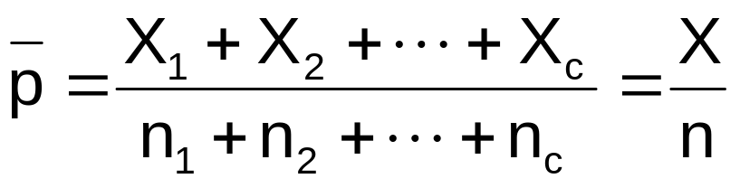

Computing the
Overall Proportion
The overall proportion is:
Expected cell frequencies for the c categories are calculated as in the 2 x 2 case, and the decision rule is the same:
Where is from the chi-squared distribution with c – 1 degrees of freedom
Decision Rule:
If , reject H₀, otherwise, do not reject H₀

Slide 17
The Marascuilo Procedure
Used when the null hypothesis of equal proportions is rejected
Enables you to make comparisons between all pairs
Start with the observed differences, p_{j} – p_{j’}, for all pairs (for j ≠ j’) . . .
. . .then compare the absolute difference to a calculated critical range

Slide 18
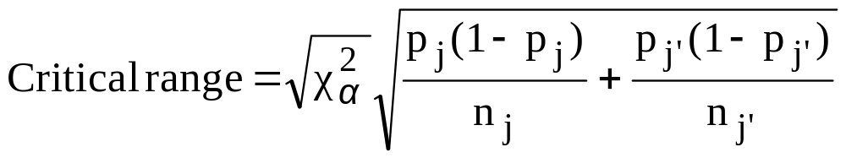
The Marascuilo Procedure
(continued)
Critical Range for the Marascuilo Procedure:
    (Note: the critical range is different for each pairwise comparison)
A particular pair of proportions is significantly different if
| p_{j} – p_{j’}| > critical range for j and j’

Slide 19

Marascuilo Procedure Example
A University is thinking of switching to a trimester academic calendar. A random sample of 100 administrators, 50 students, and 50 faculty members were surveyed
Opinion Administrators Students Faculty
Favor 63 20 37
Oppose 37 30 13
Totals 100 50 50
Using a 1% level of significance, which groups have a different attitude?

Slide 20
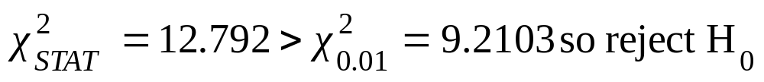
Chi-Square Test Results
H₀: π₁ = π₂ = π₃
H₁: Not all of the π_{j} are equal (j = 1, 2, 3)
Chi-Square Test: Administrators, Students, Faculty
Admin Students Faculty Total
Favor 63 20 37 120
60 30 30
Oppose 37 30 13 80
40 20 20
Total 100 50 50 200
Expected
Observed

Slide 21
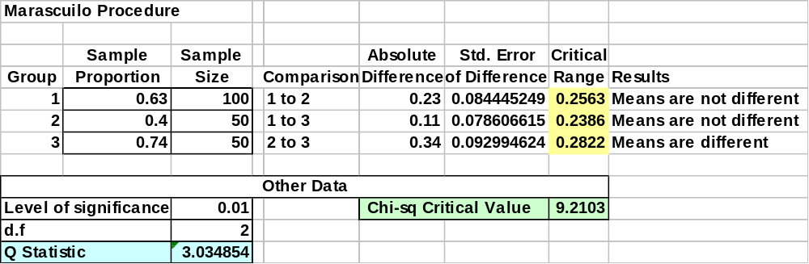
Marascuilo Procedure: Solution
Excel Output:
compare
At 1% level of significance, there is evidence of a difference in attitude between students and faculty

Slide 22
χ² Test of Independence
Similar to the χ² test for equality of more than two proportions, but extends the concept to contingency tables with r rows and c columns
H₀: The two categorical variables are independent
(i.e., there is no relationship between them)
H₁: The two categorical variables are dependent
(i.e., there is a relationship between them)

Slide 23

χ² Test of Independence
(continued)
The Chi-square test statistic is:
where:
f_{o} = observed frequency in a particular cell of the r x c table
f_{e} = expected frequency in a particular cell if H₀ is true
(Assumed: each cell in the contingency table has expected
frequency of at least 1)

Slide 24
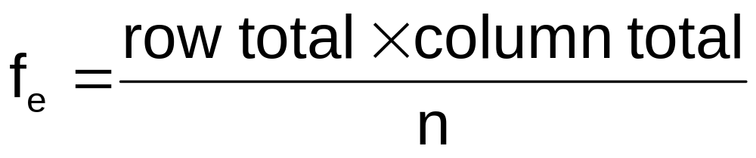
Expected Cell Frequencies
Expected cell frequencies:
Where:
row total = sum of all frequencies in the row
column total = sum of all frequencies in the column
n = overall sample size

Slide 25
Decision Rule
The decision rule is
If , reject H₀,
otherwise, do not reject H₀
Where is from the chi-squared distribution with (r – 1)(c – 1) degrees of freedom

Slide 26
Example
The meal plan selected by 200 students is shown below:
Class Standing | Number of meals per week |  |  | Total
 | 20/week | 10/week | none
Fresh. | 24 | 32 | 14 | 70
Soph. | 22 | 26 | 12 | 60
Junior | 10 | 14 | 6 | 30
Senior | 14 | 16 | 10 | 40
Total | 70 | 88 | 42 | 200

Slide 27
Example
(continued)
The hypothesis to be tested is:
H₀: Meal plan and class standing are independent
(i.e., there is no relationship between them)
H₁: Meal plan and class standing are dependent
(i.e., there is a relationship between them)

Slide 28
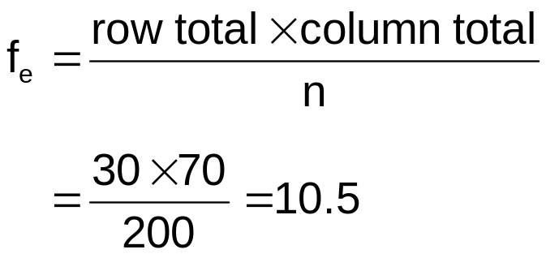
Example:
Expected Cell Frequencies
(continued)
Observed:
Class Standing | Number of meals per week |  |  | Total
 | 20/wk | 10/wk | none
Fresh. | 24 | 32 | 14 | 70
Soph. | 22 | 26 | 12 | 60
Junior | 10 | 14 | 6 | 30
Senior | 14 | 16 | 10 | 40
Total | 70 | 88 | 42 | 200
Expected cell frequencies if H₀ is true:
Class Standing | Number of meals per week |  |  | Total
 | 20/wk | 10/wk | none
Fresh. | 24.5 | 30.8 | 14.7 | 70
Soph. | 21.0 | 26.4 | 12.6 | 60
Junior | 10.5 | 13.2 | 6.3 | 30
Senior | 14.0 | 17.6 | 8.4 | 40
Total | 70 | 88 | 42 | 200
Example for one cell:

Slide 29
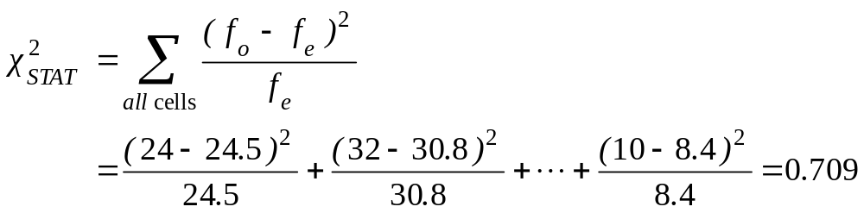
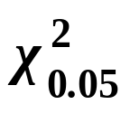
Example: The Test Statistic
(continued)
The test statistic value is:
= 12.592 from the chi-squared distribution with (4 – 1)(3 – 1) = 6 degrees of freedom

Slide 30

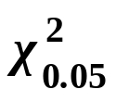
Example:
Decision and Interpretation
(continued)
Decision Rule:
If > 12.592, reject H₀, otherwise, do not reject H₀
0.05
Here,
= 0.709 < = 12.592,
so do not reject H₀
Conclusion: there is not sufficient evidence that meal plan and class standing are related at α = 0.05
0
χ²
Do not
reject H₀
Reject H₀
χ²_{0.05}=12.592

Slide 31
McNemar Test (Related Samples)
Used to determine if there is a difference between proportions of two related samples
Uses a test statistic the follows the normal distribution

Slide 32
McNemar Test (Related Samples)
(continued)
Consider a 2 X 2 contingency table:
 | Condition 2
Condition 1 | Yes | No | Totals
Yes | A | B | A+B
No | C | D | C+D
Totals | A+C | B+D | n

Slide 33
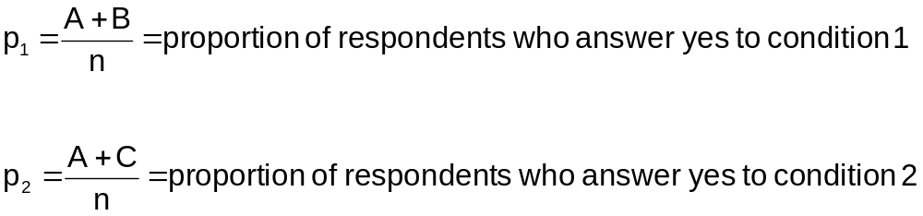
McNemar Test (Related Samples)
(continued)
The sample proportions of interest are
Test H₀: π₁ = π₂
  (the two population proportions are equal)
H₁: π₁ ≠ π₂
  (the two population proportions are not equal)

Slide 34
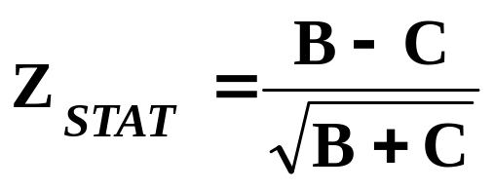
McNemar Test (Related Samples)
(continued)
The test statistic for the McNemar test:
where the test statistic Z is approximately normally distributed

Slide 35
McNemar Test
Example
Suppose you survey 300 homeowners and ask them if they are interested in refinancing their home. In an effort to generate business, a mortgage company improved their loan terms and reduced closing costs. The same homeowners were again surveyed. Determine if change in loan terms was effective in generating business for the mortgage company. The data are summarized as follows:

Slide 36
McNemar Test
Example
Survey response before change | Survey response after change
 | Yes | No | Totals
Yes | 118 | 2 | 120
No | 22 | 158 | 180
Totals | 140 | 160 | 300
Test the hypothesis (at the 0.05 level of significance):
H₀: π₁ ≥ π₂: The change in loan terms was ineffective
H₁: π₁ < π₂: The change in loan terms increased business

Slide 37
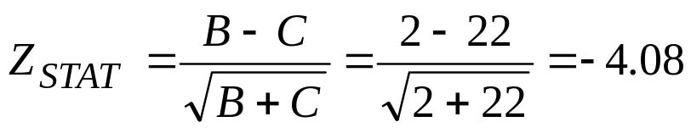
McNemar Test
Example
The critical value (0.05 significance) is Z_{0.05} = -1.645
The test statistic is:
Survey response before change | Survey response after change
 | Yes | No | Totals
Yes | 118 | 2 | 120
No | 22 | 158 | 180
Totals | 140 | 160 | 300
Since Z_{STAT} = -4.08 < -1.645, you reject H₀ and conclude that the change in loan terms significantly increase business for the mortgage company.

Slide 38
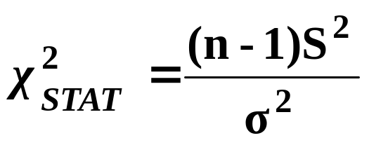
Chi-Square Test for a Variance or Standard Deviation
A χ² test statistic is used to test whether or not the population variance or standard deviation is equal to a specified value:
  Where n = sample size
  S² = sample variance
  σ² = hypothesized population variance
  follows a chi-square distribution with n – 1 d.f.

Slide 39
Wilcoxon Rank-Sum Test for Differences in 2 Medians
Test two independent population medians
Populations need not be normally distributed
Distribution free procedure
Used when only rank data are available
Must use normal approximation if either of the sample sizes is larger than 10

Slide 40
Wilcoxon Rank-Sum Test: Small Samples
Can use when both n₁ , n₂ ≤ 10
Assign ranks to the combined n₁ + n₂ sample observations
  If unequal sample sizes, let n₁ refer to smaller-sized sample
  Smallest value rank = 1, largest value rank = n₁ + n₂
  Assign average rank for ties
Sum the ranks for each sample: T₁ and T₂
Obtain test statistic, T₁ (from smaller sample)

Slide 41
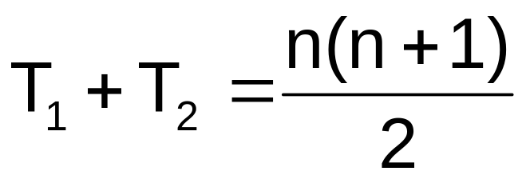
Checking the Rankings
The sum of the rankings must satisfy the formula below
Can use this to verify the sums T₁ and T₂
where n = n₁ + n₂

Slide 42
Wilcoxon Rank-Sum Test:
Hypothesis and Decision Rule
M₁ = median of population 1; M₂ = median of population 2
Test statistic = T₁ (Sum of ranks from smaller sample)
Two-Tail Test
Left-Tail Test
Right-Tail Test
H₀: M₁ = M₂
H₁: M₁ ≠ M₂
H₀: M₁ ≥ M₂
H₁: M₁ < M₂
H₀: M₁ ≤ M₂
H₁: M₁ > M₂
Reject
Do Not Reject
Reject
Reject
Do Not Reject
Do Not Reject
Reject
T_{1L}
T_{1U}
T_{1L}
T_{1U}
Reject H₀ if T₁ ≤ T_{1L}
or if T₁ ≥ T_{1U}
Reject H₀ if T₁ ≤ T_{1L}
Reject H₀ if T₁ ≥ T_{1U}

Slide 43

Wilcoxon Rank-Sum Test: Small Sample Example
Sample data are collected on the capacity rates (% of capacity) for two factories.
Are the median operating rates for two factories the same?
For factory A, the rates are 71, 82, 77, 94, 88
For factory B, the rates are 85, 82, 92, 97
Test for equality of the population medians
at the 0.05 significance level

Slide 44
Wilcoxon Rank-Sum Test: Small Sample Example
(continued)
Ranked
Capacity
values:
Capacity |  | Rank
Factory A | Factory B | Factory A | Factory B
71 |  | 1
77 |  | 2
82 |  | 3.5
 | 82 |  | 3.5
 | 85 |  | 5
88 |  | 6
 | 92 |  | 7
94 |  | 8
 | 97 |  | 9
Rank Sums: |  | 20.5 | 24.5
Tie in 3rd and 4th places

Slide 45
Wilcoxon Rank-Sum Test: Small Sample Example
(continued)
Factory B has the smaller sample size, so the test statistic is the sum of the Factory B ranks:
T₁ = 24.5
The sample sizes are:
n₁ = 4 (factory B)
n₂ = 5 (factory A)
The level of significance is α = .05

Slide 46
Wilcoxon Rank-Sum Test: Small Sample Example
(continued)
n₂ | α |  | n₁
 | One-Tailed | Two-Tailed | 4 | 5
4
5 | .05 | .10 | 12, 28 | 19, 36
 | .025 | .05 | 11, 29 | 17, 38
 | .01 | .02 | 10, 30 | 16, 39
 | .005 | .01 | --, -- | 15, 40
6
Lower and Upper Critical Values for T₁ from Appendix table E.8:
T_{1L} = 11 and T_{1U} = 29

Slide 47
Wilcoxon Rank-Sum Test:
Small Sample Solution
(continued)
α = .05
n₁ = 4 , n₂ = 5
Test Statistic (Sum of ranks from smaller sample):
T₁ = 24.5
Decision:
Conclusion:
Two-Tail Test
H₀: M₁ = M₂
H₁: M₁ ≠ M₂
Do not reject at α = 0.05
Reject
Do Not Reject
Reject
T_{1L}=11
T_{1U}=29
There is not enough evidence to prove that the medians are not equal.
Reject H₀ if T₁ ≤ T_{1L}=11
or if T₁ ≥ T_{1U}=29

Slide 48
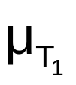
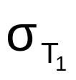
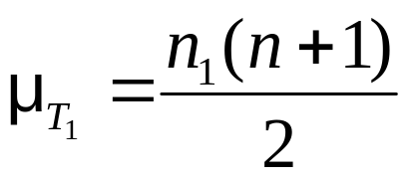
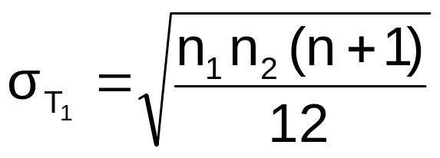
Wilcoxon Rank-Sum Test
(Large Sample)
For large samples, the test statistic T₁ is approximately normal with mean and standard deviation :
  Must use the normal approximation if either n₁
  or n₂ > 10
  Assign n₁ to be the smaller of the two sample sizes
  Can use the normal approximation for small samples

Slide 49
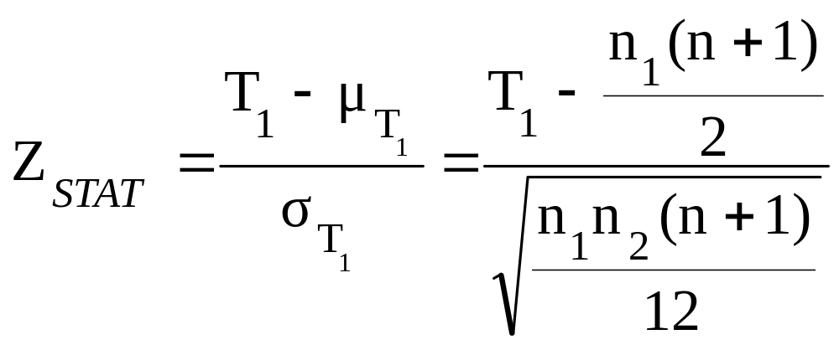
Wilcoxon Rank-Sum Test
(Large Sample)
(continued)
The Z test statistic is
Where Z_{STAT} approximately follows a standardized normal distribution

Slide 50
Wilcoxon Rank-Sum Test: Normal Approximation Example
Use the setting of the prior example:
The sample sizes were:
n₁ = 4 (factory B)
n₂ = 5 (factory A)
The level of significance was α = .05
The test statistic was T₁ = 24.5

Slide 51
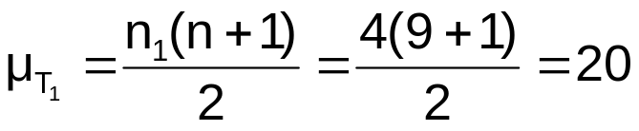
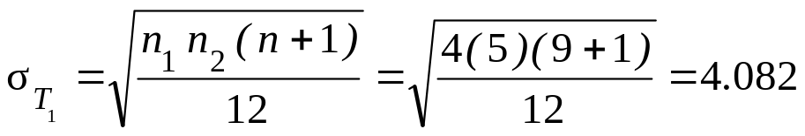
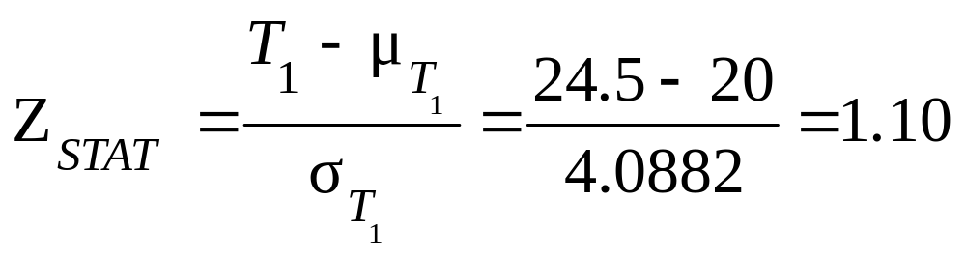
Wilcoxon Rank-Sum Test:
Normal Approximation Example
(continued)
The test statistic is
Z = 1.10 is not greater than the critical Z value of 1.96 (for α = .05) so we do not reject H₀ – there is not sufficient evidence that the medians are not equal

Slide 52
Wilcoxon Signed Ranks Test
A nonparametric test for two related populations
Steps:
  For each of n sample items, compute the difference, D_{i}, between two measurements
  Ignore + and – signs and find the absolute values, |D_{i}|
  Omit zero differences, so sample size is n’
  Assign ranks R_{i} from 1 to n’ (give average rank to ties)
  Reassign + and – signs to the ranks R_{i}
  Compute the Wilcoxon test statistic W as the sum of the positive ranks

Slide 53
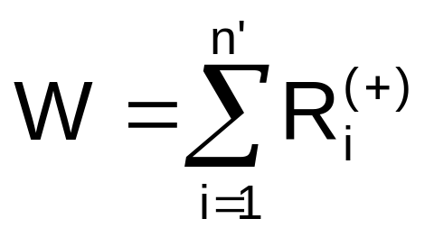
Wilcoxon Signed Ranks
Test Statistic
The Wilcoxon signed ranks test statistic is the sum of the positive ranks:
For small samples (n’ < 20), use Table E.9 for the critical value of W

Slide 54
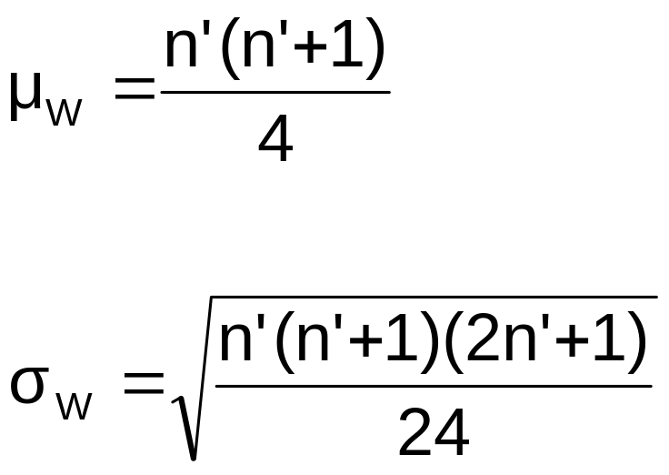
Wilcoxon Signed Ranks
Test Statistic
For samples of n’ > 20, W is approximately normally distributed with

Slide 55
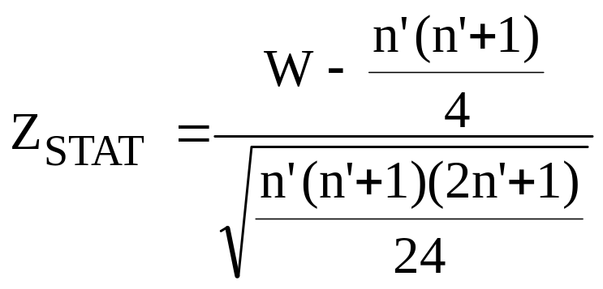
Wilcoxon Signed Ranks Test
The large sample Wilcoxon signed ranks Z test statistic is
To test for no median difference in the paired values:
  H₀: M_{D} = 0
  H₁: M_{D} ≠ 0

Slide 56
Kruskal-Wallis Rank Test
Tests the equality of more than 2 population medians
Use when the normality assumption for one-way ANOVA is violated
Assumptions:
  The samples are random and independent
  Variables have a continuous distribution
  The data can be ranked
  Populations have the same variability
  Populations have the same shape

Slide 57
Kruskal-Wallis Test Procedure
Obtain rankings for each value
  In event of tie, each of the tied values gets the average rank
Sum the rankings for data from each of the c groups
  Compute the H test statistic

Slide 58
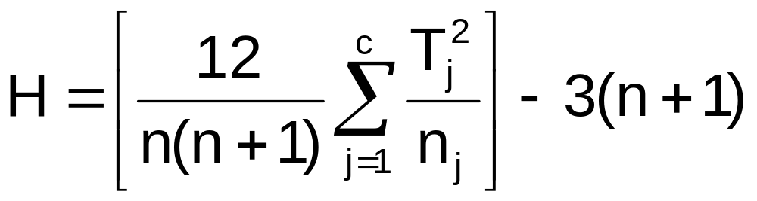
Kruskal-Wallis Test Procedure
(continued)
The Kruskal-Wallis H-test statistic:
(with c – 1 degrees of freedom)
where:
n = sum of sample sizes in all groups
c = Number of groups
T_{j} = Sum of ranks in the j^{th} group
n_{j} = Number of values in the j^{th} group (j = 1, 2, … , c)

Slide 59
Kruskal-Wallis Test Procedure
(continued)
Complete the test by comparing the calculated H value to a critical χ² value from the chi-square distribution with c – 1 degrees of freedom
Decision rule
  Reject H₀ if test statistic H > χ²_{α}
  Otherwise do not reject H₀
α
0
χ²
Do not
reject H₀
Reject H₀
χ²_{α}

Slide 60

Kruskal-Wallis Example
Do different departments have different class sizes?
Class size (Math, M) | Class size (English, E) | Class size (Biology, B)
23 45 54 78 66 | 55 60 72 45 70 | 30 40 18 34 44

Slide 61
Kruskal-Wallis Example
(continued)
Do different departments have different class sizes?
Class size (Math, M) | Ranking | Class size (English, E) | Ranking | Class size (Biology, B) | Ranking
23 41 54 78 66 | 2 6 9 15 12 | 55 60 72 45 70 | 10 11 14 8 13 | 30 40 18 34 44 | 3 5 1 4 7
 | Σ = 44 |  | Σ = 56 |  | Σ = 20

Slide 62
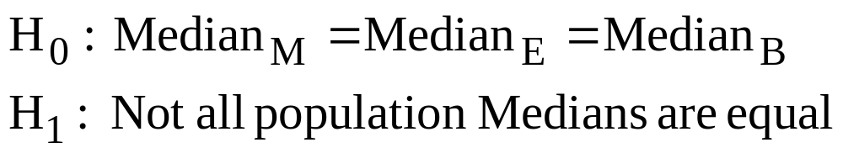
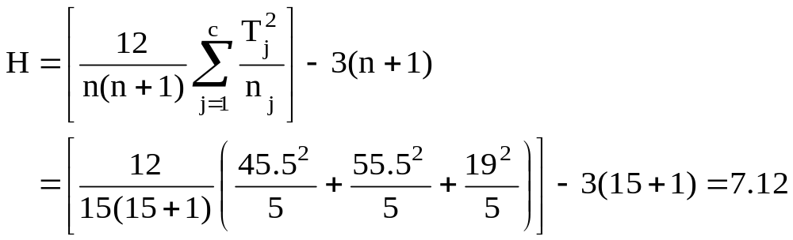
Kruskal-Wallis Example
(continued)
The H statistic is

Slide 63
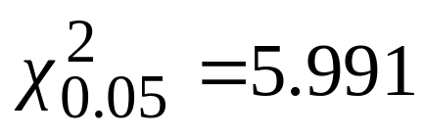
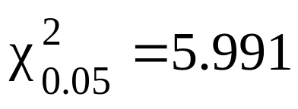
Kruskal-Wallis Example
(continued)
Compare H = 7.12 to the critical value from the chi-square distribution for 3 – 1 = 2 degrees of freedom and α = 0.05:
Since H = 7.12 > ,
reject H₀
There is sufficient evidence to reject that the population medians are all equal

Slide 64
Friedman Rank Test
Use the Friedman rank test to determine whether c groups (i.e., treatment levels) have been selected from populations having equal medians
H₀: M_{.1} = M_{.2} = . . . = M_{.c}
H₁: Not all M_{.j} are equal (j = 1, 2, …, c)

Slide 65
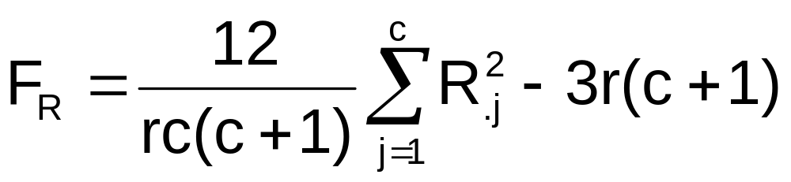

Friedman Rank Test
(continued)
Friedman rank test for differences among c medians:
where = the square of the total ranks for group j
r = the number of blocks
c = the number of groups

Slide 66
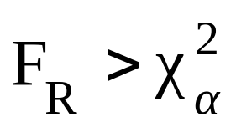
Friedman Rank Test
(continued)
The Friedman rank test statistic is approximated by a chi-square distribution with c – 1 d.f.
Reject H₀ if
Otherwise do not reject H₀

Slide 67
Chapter Summary
Developed and applied the χ² test for the difference between two proportions
Developed and applied the χ² test for differences in more than two proportions
Applied the Marascuilo procedure for comparing all pairs of proportions after rejecting a χ² test
Examined the χ² test for independence
Applied the McNemar test for proportions from two related samples
Presented the χ² test for a variance or a standard deviation

Slide 68
Chapter Summary
(continued)
Used the Wilcoxon rank sum test for two population medians
Presented the Wilcoxon signed ranks test for comparing paired samples
Applied the Kruskal-Wallis H-test for multiple population medians
Applied the Friedman rank test for comparing multiple population medians in a randomized block design

